Slide 1
Ham 403
Mo-Kan Regional Council of
Amateur Radio Organizations, Inc.
Copyright © 20123– All Rights Reserved
Introduction to the Mo-Kan Regional Council of
Amateur Radio Organizations
Version 1.0 06JUN23

Slide 2
Ham 403-Introduction to the Mo-Kan Council
Welcome to Ham 403, Introduction to the Mo-Kan Regional Council of Amateur Radio Organizations Inc.
The purpose of this class is to provide an introduction of what the Mo-Kan Regional Council is, what the Council does, and what the Council is doing for the region’s Amateur Radio Organization.
There is no prerequisite to this class. We’re Glad You’re Here!

Slide 3
Ham 403-Introduction to the Mo-Kan Council
About This Presentation:
The Mo-Kan Regional Council is a Work in Progress. What is provided in this presentation is not just an introduction, but an overview of what the Council is and where we hope it will be going in the future.
Our intent is to provide not only what the Council is and what is does, but to help learn ideas from the organizations in our region to help make the council into something even better.

Slide 4
Who is the Mo-Kan Regional Council?
The Mo-Kan Regional Council is a “Club of Clubs or Organizations” which have a unique interest in Amateur Radio. Our Bylaws define our mission as:
-Coordinate and foster activities, efforts, and points of the view of the various amateur radio clubs and organizations from the region.
-Coordinate and provide meaningful recognition of individuals from the region who have made notable contributions to amateur radio.
-Serve as the combined voice for amateur radio on issues affecting amateur radio within our region.
-Create solidarity of purpose, a united voice, and a source of pride in everything that is the amateur radio community of our region.
Mo Kan Regional Council of
Amateur Radio Organizations, Inc.

Slide 5
Who Can Be a Member of the Mo-Kan Regional Council?

Slide 6
Who Can Be a Member?
The Council consists of Clubs, Special Interest or Service Organizations, and Vendors or Manufacturers of Amateur Radio Equipment or Services. Our region is defined as a 150 mile radius of Kansas City, and includes parts of both Kansas and Missouri.
While we are affiliated with the ARRL, the Council does not fill that National Role, nor do we govern or dictate to the individual, local clubs or organizations.
We exist to coordinate and facilitate the efforts of all such organizations.
Mo Kan Regional Council of
Amateur Radio Organizations, Inc.

Slide 7
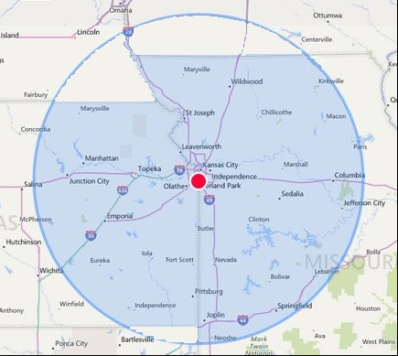
Who Can Be a Member?
Our Region:
From Our Bylaws…
For the purpose of membership, the Kansas City Bi-State Region shall be described as any location in the State of Missouri or Kansas within a 150 statute mile radius from the intersection of Interstate 435 and Stateline Road, in Kansas City, Missouri / Leawood, Kansas.

Slide 8
Who Can Be a Member?
Member – Regular Member
Any established amateur radio club or organization from the Kansas City Bi-State Region with a constitution or by-laws which has sustained a current membership of five or more individual members for 365 days or more at the time of application for membership. Regular members may vote on all elections and issues brought forward for a vote, may serve on committees , participate in any official discussions on any issues brought before the association and participate in any events of activities of the association.

Slide 9
Who Can Be a Member?
Member – Special Interest Organization
Any established amateur radio organization with a particular focus or mission. Examples of such organizations might include, but are not limited to a County ARES Group, Salvation Army’s SATERN, KCHEART, to name a few. Special Interest Organization members may vote on all elections and issues brought forward for a vote, may serve on committees , participate in any official discussions on any issues brought before the association and participate in any events of activities of the association.

Slide 10
Who Can Be a Member?
Member – Vendor Organization
Any manufacturer or seller of products or services of interest to the amateur radio community from the region. Vendor Organization members may participate in any official discussions on any issues brought before the association and may participate in any events of activities of the association. Vendor Organizations may not vote on officers or issues.

Slide 11
Mo-Kan Council Projects
Let’s Talk About Some of the Things We’re Working on!

Slide 12
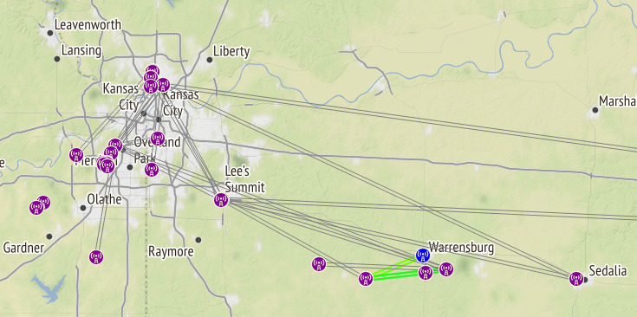
Mo-Kan Projects
KC Mesh Group
A group of Amateur Radio Operators in the Kansas City Metro Area that are working on building out the Amateur Radio Emergency Data Network in the Region.
https://www.kcmesh.org

Slide 13
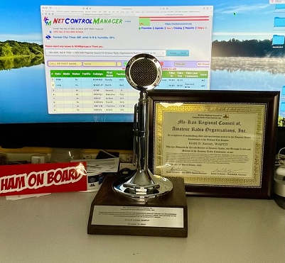
Mo-Kan Projects
Mo-Kan Eagle Awards
The Eagle Awards has been established to recognize the significant efforts and success of individuals from the Kansas City Region who have accomplished great work or outstanding service to the Amateur Radio Community of the Region which would be considered above and beyond normal expectations.
http://mokancouncil.org/awards.html/

Slide 14
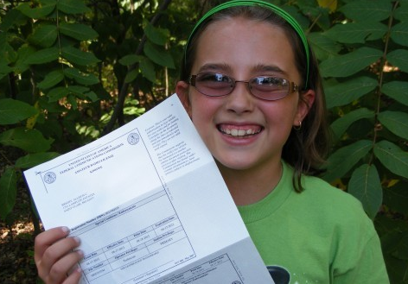
Mo-Kan Projects
Traveling Elmers Table
At Hamfests and Events, host a table where new or interested Hams can be introduced by referral to Amateur Radio Subject Matter Experts from the various facets of Amateur Radio. This process may also be used to introduce a new Ham to an Amateur Radio Club based on criteria of interest to that particular Ham.
http://mokancouncil.org/ElmerProject.htm

Slide 15
Mo-Kan Projects
Ham 400 Project
Training on Club Creation, Club Governance, and topics relevant and specific to Amateur Radio Clubs and Organizations.
This presentation is part of the Ham 400 Project!
http://mokancouncil.org/Ham400Project.htm

Slide 16
Who Is A Member of the Council

Slide 17
Council Members
Our Membership Includes:
KC Hamlink Special Service Organization
Larry’s List
Special Service Organization
Associated Radio
Vendor Organization
Johnson County Radio Amateurs
Regular Member
Raytown Amateur Radio Club
Regular Member
WW1USA
Regular Member
Jayhawk Amateur Radio Society
Regular Member
Ararat Shrine Amateur Radio Club Regular Member
Warrensburg Area Amateur Radio Club
Regular Member
Santa Fe Trail Amateur Radio Club
Regular Member
Boy Scouts of America – Heart of America Council
Special Service Organization
Metropolitan Emergency Communications Council (MECC)
Special Service Organization
Platte County Amateur Radio Group
Regular Member
Jayhawk Amateur Radio Society
Regular Member

Slide 18
Council Members
Our Membership Includes:
Mine Creek Amateur Radio Club Regular Member
Salvation Army S.A.T.E.R.N.
Special Service Organization
Independence/Eastern Jackson County Emergency Management
Special Service Organization
Amateur Radio Emergency Services Kansas Section, Dist. 4 Zone c
Special Service Organization
Raytown Amateur Radio Club
Regular Member
Sedalia-Pettis Amateur Radio Klub (SPARK)
Regular Member
W5YI Testing & Gorden West Training of Independence Special Service Organization
Olathe Ensor Foundation, Supporting the Ensor Park and Museum
Special Service Organization
Add Your Club or Organization Here!

Slide 19
Where Do We Go From Here?

Slide 20
Where Do We Go From Here?
We’re Always Looking for New Project, New Ideas, and New Members!
Some Ideas in Progress:
Mo-Kan Symposium
Special Event Station Management (Training)
ARRL Foundation Grant
Recruitment Drive
Radio Club Needs Survey
…And more to come!

Slide 21
Where Do We Go From Here?
We would LOVE to have your Amateur Radio Club to become part of the Mo-Kan Regional Council of Amateur Radio Organizations!
Simply talk to me about the opportunity.

Slide 22
Q & A
Do You Have Any Questions?

Slide 23
Thank You!
The Mo-Kan Regional Council of
Amateur Radio Organizations

